Slide 1


HYPERLEDGER FABRIC FOR THE ENTERPRISE Privacy and Security Strategies
Presentation
Grant Steinfeld IBM Developer Advocate – Blockchain and JVM
@gsteinfeld
https://bit.ly/2xf0PvK
https://www.linkedin.com/in/grant-steinfeld/

Slide 2
"Blockchains are the distributed ledger technology underlying bitcoin and other cryptocurrencies. More broadly, a blockchain is a mechanism for updating truth states in distributed network computing, producing consensus trust and serving as a new form of general computational substrate."
Melanie Swan
Config Block
0
Config
Block
1
Transaction
Block
2
Transaction
Block
3
Worldstate
Genesis
Blockchain

Slide 3
Hyperledger Fabric permissioned private blockchain Trust and Identity Security and Privacy

Slide 4
PUBLIC VS PRIVATE blockchains
 | Public | Private
Access level | anyone | 1-n organizations
Participation | Permissionless Anonymous | Permissioned Identities are known Pre approved participants invited
Security / Consensus | POW POS | Voting
Performance | Single chain - Slow | Lighter/ Channel - Segmented chains Fast
Notes:
Public and private blockchains are both decentralized, peer-to-peer networks where each participant maintains a replica of a shared ledger that stores digitally signed transactions. This ledger can only be appended to, but not edited. Participants in a blockchain keep this ledger in sync through a consensus protocol. This creates a guarantee on the immutability of the ledger which cannot be corrupted even if there are some malicious participants on the blockchain.
The difference between public and private blockchain is related to the type of participants allowed within the network that maintain the ledger and execute the consensus protocol.

Slide 5
IDENTITY!
Notes:
Private Permissioned Blockchains have deviated from Satoshi original concepts of Public Anonymous Blockchains
Additional security - ACL

Slide 6



The Facts
Cyber attacks cost businesses as much as $400 billion a year.²
Hackers stole $40 million from Binance cryptocurrency exchange
Banks spend $1 billion a year on identity management solutions²
175M records breached in 2017 that exposed millions of people’s identities¹
Coincheck Hot Wallet: NEM coins $534 Million
It could have been your identity.
Notes:
Hot wallet refers to any cryptocurrency wallet that is connected to the internet. Generally hot wallets are easier to set up, access, and accept more tokens. But, hot wallets are also more susceptible to hackers, possible regulation, and other technical vulnerabilities
http://www.idtheftcenter.org/images/breach/2017Breaches/DataBreachReport_2017.pdf [1]
https://www.wired.com/beyond-the-beyond/2017/07/global-cybercrime-costs-trillion-dollars-maybe-3/ [2]
https://www.accenture.com/_acnmedia/Accenture/Conversion-Assets/DotCom/Documents/Global/PDF/Dualpub_9/Accenture-Future-Identity-Banking.pdf [3]

Slide 7
HLF REAL USE CASES
Supply Chain
Trade Financing
Education and Training
Smart Energy / IoT / Agriculture Management
Notes:
“Hyperledger is an open source collaborative effort created to advance cross-industry blockchain technologies. It is a global collaboration, including leaders in finance, banking, Internet of Things, supply chains, manufacturing, and Technology.”

Slide 8
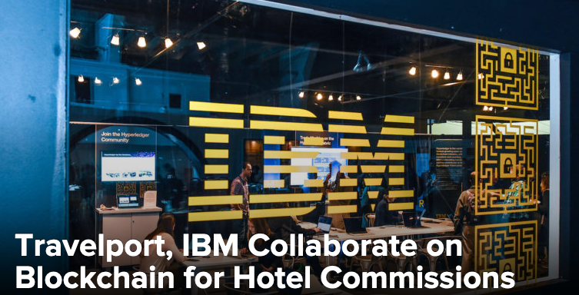
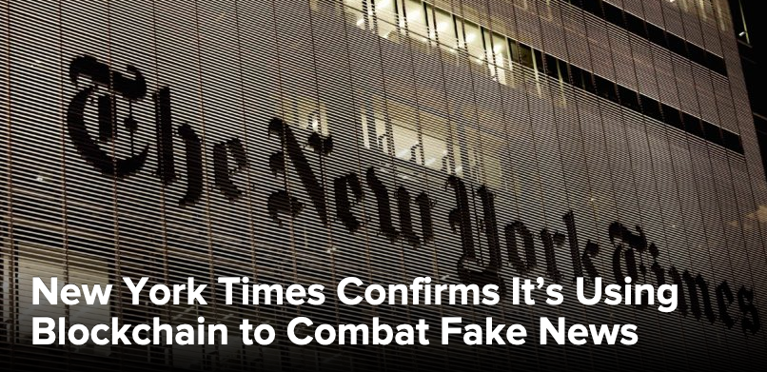


HLF -> IBM ENTERPRISE - SHOWCASE
guarantee commissions paid to travel agencies.
combat misinformation and adulterated media
food supply chain -unprecedented visibility and veracity into the sourcing and certification of fresh produce and proteins.
IBM Maersk - TradeLens blockchain-enabled digital shipping platform continues
expansion with addition of major ocean carriers Hapag-Lloyd and Ocean Network Express
Notes:
“With travelers having endless options for accommodations, a booking alone is not enough to provide a commission to an agency… With blockchain, we’re able to reduce costs and ease burdens for all parties involved by improving transparency, accuracy and efficiencies to enhance the process.”
TradeLens blockchain-enabled digital shipping platform continues expansion with addition of major ocean carriers Hapag-Lloyd and Ocean Network Express
News Provenance Project explains how the storied newspaper’s Research and Development team plans to use Hyperledger Fabric’s permissioned blockchain to authenticate news photographs in partnership with IBM Garage, the tech giant’s accelerator program.
The project aims to combat misinformation and adulterated media, which it argues harms small and large publishers alike. “News consumers [who] are deceived and confused…eventually become fatigued and apathetic to news,” the website says.

Slide 9
















Global trade is highly inefficient and burdened by paper-based processes
Inland Transportation
Data trapped in organizational silos
Manual, time-consuming, paper-based processes
Clearance takes too long and is often subject to fraud
High costs and poor customer service .
Customs Brokers
Shippers / Beneficial Cargo Owner
Supply Chain Visibility Systems
Customs Systems
Trade Associations
Ports and Terminals
Supply Chain / Transportation Management Systems
Ocean Carriers
Freight Forwarders / 3PLs
Authorities
Port Community Systems; Terminal Operating Systems
Financial / Insurance Services

Slide 10






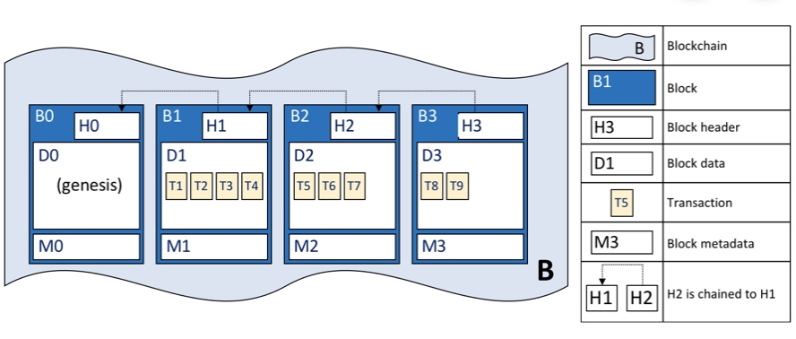









The TradeLens Platform - Digitizing the global supply chain
Inland Transportation
Connects the ecosystem
Drives true information sharing Fosters collaboration and trust Spurs innovation
Open
Customs Brokers
Shippers / Beneficial Cargo Owner
Supply Chain Visibility Systems
Customs Systems
Ports and Terminals
THE PLATFORM IS BUILT ON AN OPEN TECHNOLOGY STACK AND IS UNDERPINNED BY BLOCKCHAIN TECHNOLOGY
Trade Associations
Supply Chain / Transportation Management Systems
Ocean Carriers
Freight Forwarders / 3PLs
Authorities
Port Community Systems; Terminal Operating Systems
Financial / Insurance Services

Slide 11




TradeLens and Blockchain
Blockchain addresses the underlying challenges inherent in collaborating across a distributed, fragmented supply chain ecosystem
Shared ledger
Smart contract
privacy
TRUST
Append-only distributed system of record shared across business network
A network of industry participants maintains a distributed, permissioned ledger with copies of document filings, relevant supply chain events, authority approval status, and full audit history; every change results in a new, immutable block
Shared business logic governing what transactions may be written to the ledger
Cross-organizational business processes, such as import and export clearance, are pre-programmed and built into Blockchain and distributed to and executed on the network, preventing any member from changing the business logic
Ensuring appropriate visibility; transactions are secure, authenticated and verifiable
Cryptography enables permissioned access so only the parties participating in a specific shipment can submit, edit or approve related data
Transactions are endorsed by relevant participants
Information such as documentation filings and authority approvals can only be changed if endorsed by the parties taking part in the shipment; full audit history maintained on the Blockchain

Slide 12
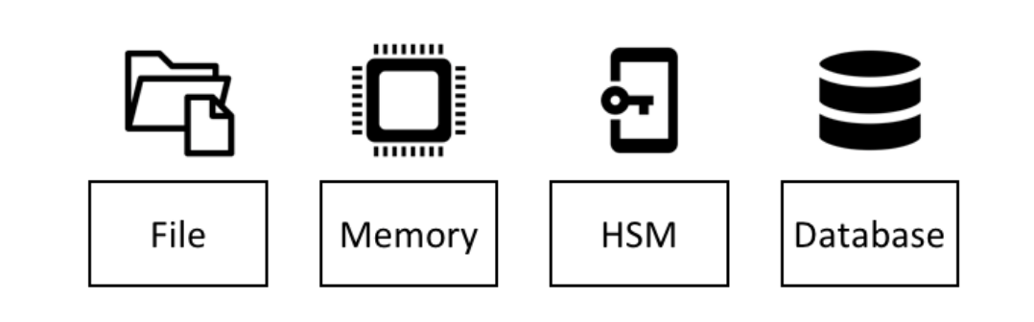
PKI for Identity - Fabric Wallets
Notes:
Permissioned membership provides a trusted blockchain network, where participants know that all transactions can be detected and traced by authorized regulators and auditors.
FileSystem: Default – encrypted disks important
Memory: in app, transient
Hardware Security Module (HSM): Best choice. ultra-secure, tamper-proof device stores digital identity keys.
HSMs can be locally attached to your computer or network accessible. Most HSMs provide the ability to perform on-board encryption - the private key never leave the HSM.
CouchDB : Rare – helpful backup but vulnerable

Slide 13
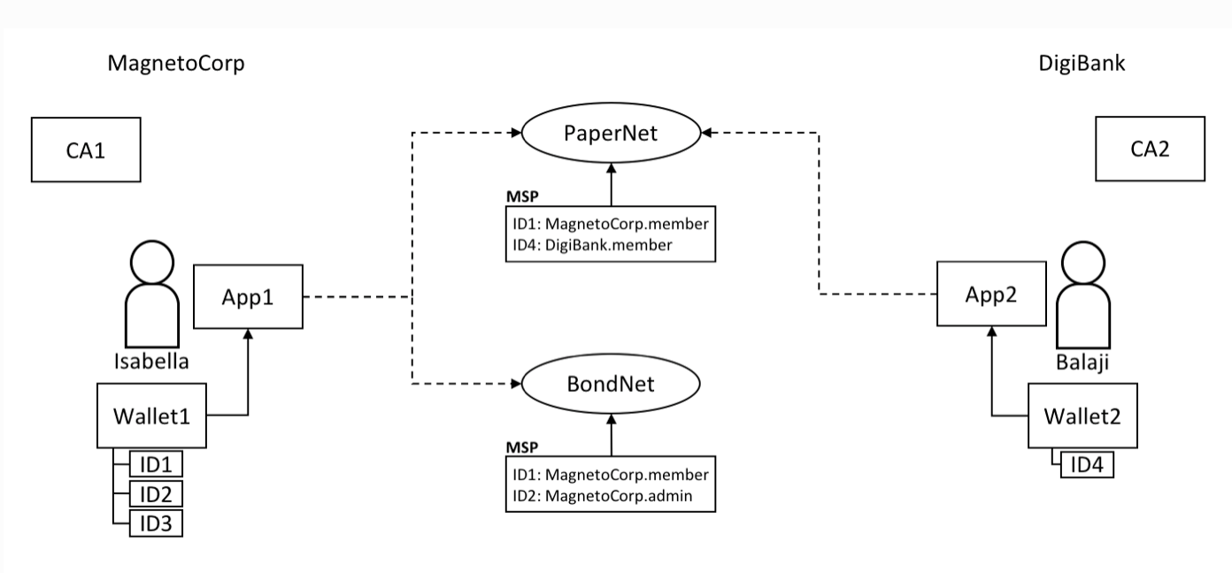
Fabric Wallet – Access rights
Attr. member
Attr. admin
Notes:
Two users, Isabella and Balaji have wallets containing different identities
they can use to connect to different network channels, PaperNet and BondNet.
single wallet can hold multiple identities, each issued by a particular Certificate Authority.
Each identity has a standard structure comprising a descriptive label, an X.509 certificate containing a public key, a private key, and some Fabric-specific metadata.
hold identities that are used by applications on behalf of users to access Fabric network resources
A wallet contains a set of user identities. An application run by a user selects one of these identities when it connects to a channel.
Access rights to channel resources, such as the ledger, are determined using this identity in combination with an MSP.

Slide 14
Policies fundamental to the way Fabric works -> identity (or set of identities) -> associated with a request -> checked against the policy associated with the resource needed
Notes:
Endorsement policies are used to determine whether a transaction has been appropriately endorsed.
The policies defined in the channel configuration are referenced as modification policies as well as for access control, and are defined in the channel configuration itself.

Slide 15
Membership Service Provider (MSP)
MSP is a module for the abstraction of a membership operations, because
Certificate control is hard!
MSP abstracts away:
all cryptographic mechanisms
protocols behind issuing certificates
validating certificates
user authentication
interoperability across different membership standards
LDAP
Active Director
Other auth CA’s
This provides modularity of membership operations, and
Notes:
An MSP may define their own notion of identity, and the rules by which those identities are governed (identity validation) and authenticated (signature generation and verification).
A Hyperledger Fabric blockchain network can be governed by one or more MSPs.

Slide 16
Certificate Revocation
If member of Network is removed for some reason, certificates are revoked
Revocation lists are propagated to all MSP `registries` to ensure safety of data

Slide 17
Attribute Based Access Control
To determine if a user can or cannot execute a specific chaincode
User Attribute Certificate Authority Certifies
id: during enrollment
affiliation: with what entity
attributeName: e.g. `position` or `role`
attributeValue: e.g. `software engineer` or `reviewer`
validFrom
validTo
Notes:
Certificates can store metadata like names and roles, which can be accessed by the chain code in SmartContracts, so as to enforce correct authorization and read-write permissions

Slide 18
const ca = gateway.getClient().getCertificateAuthority(); const adminIdentity = gateway.getCurrentIdentity(); console.log(`AdminIdentity: + ${adminIdentity}`);
JavaScript::Get Public Certificate attributes
AdminIdentity: + {"name":"voterApp-admin",
"mspid":"votermsp",
"roles":[],"affiliation":"","enrollmentSecret":"","enrollment":{"signingIdentity":"00976f0fd66e107c8a67f5d978d864ca10283018452f216ec98c61992e063f1b","identity":{"certificate":"-----BEGIN CERTIFICATE-----\nMIICcTCCAhigAwIBAgIUUIBBRu/ …
/oU\n+nlfELEQBfm+78aqMwtiaCblpwIgE4WexVHK8NQ2hav6cuKuf4AfVPYuF63vRC78\ni1x6jq8=\n-----END CERTIFICATE-----\n"}}}

Slide 19
Consensus in HLF
permissioned voting-based consensus
assumption that business blockchain networks operate in an environment of partial trust.
Advantage low-latency finality.
When a majority of nodes validates a transaction or block, consensus exists and finality occurs.
Majority ratio, typically 2/3^{rd,} is `user defined` configuration in Policy
Notes:
Consensus algorithm is a process in computer science used to achieve agreement on a single data value among distributed processes or systems. Consensus algorithms are designed to achieve reliability in a network involving multiple unreliable nodes. Solving that issue – known as the consensus problem – is important in distributed computing and multi-agent systems.
Because voting-based algorithms typically require nodes to transfer messages to each of the other nodes on the network, the more nodes that exist on the network, the more time it takes to reach consensus. This results in a trade-off between scalability and speed.

Slide 20
3 nodes for Consensus
Consensus in Hyperledger Fabric is broken out into 3 phases:
Endorsement
Ordering
Validation
Orderers
collect and distribute proposed ledger updates from applications for peers to validate and include on the ledger.

Slide 21


Hyperledger Fabric Architecture
CA: Certificate Authority
Fabric-CA
Membership
MSP Services
optional
Admin
Peer
(1) Endorse
Endorser
Client
Application
SDK (HFC)
Committer
(2) Order
O
O
'
(3) Validate
Ledger
Wallet
Chaincode
A
O
B
Events
(4) Notify
Ordering-Service
Hyperledger Fabric Network
Notes:
start phase 1, applications generate a transaction proposal which they send to each of the required set of peers for endorsement. Each of these endorsing peers then independently executes a chaincode using the transaction proposal to generate a transaction proposal response. It does not apply this update to the ledger, but rather simply signs it and returns it to the application. Phase 1 ends when the application receives signed proposal responses from sufficient peers.
The second phase of the transaction workflow is the packaging phase. The orderer is pivotal to this process — it receives transactions containing endorsed transaction proposal responses from many applications, and orderes the transactions into blocks
Validation and commit
At the end of phase 2, we see that orderers have been responsible for the simple but vital processes of collecting proposed transaction updates, ordering them, and packaging them into blocks, ready for distribution to the peers.
final phase of the transaction workflow involves the distribution and subsequent validation of blocks from the orderer to the commiter peers, where they can be applied to the ledger.
Specifically, at each peer, every transaction within a block is validated to ensure that it has been consistently endorsed by all relevant organizations before it is applied to the ledger.
Failed transactions are retained for audit, but are not applied to the ledger.
This entire transaction workflow process is called consensus because all peers have reached agreement on the order and content of transactions, in a process that is mediated by orderers. Consensus is a multi-step process and applications are only notified of ledger updates when the process is complete — which may happen at slightly different times on different peers.

Slide 22
Ordering Service – 3 consensus protocols
Apache Kafka and Zookeeper
Crash Fault Tolerance
Solo – dev only
Raft ( recommended )
Distributed ordering
Future Multiple ordering plugins are being developed:
BFT Smart
Simplified Byzantine Fault Tolerance (SBFT)
Honey Badger of BFT
Notes:
3 consensus protocols expected:
Raft – Allows a more distributed ordering service - https://developer.ibm.com/articles/blockchain-hyperledger-fabric-ordering-decentralization/
SOLO - single node for development. Like No-ops but single node and proper consensus.
Kafka – ordering nodes need to be trusted for confidentiality, ordering-service must not leak across channels. Peers not trusted. Access control on the channel. The ordering-service sees the transactions, unless encrypted by the chaincode. Crash fault tolerant.
Raft offers a generic way to distribute a state machine across a cluster of computing systems, ensuring that each node in the cluster agrees upon the same series of state transitions. It has a number of open-source reference implementations, with full-specification implementations in Go, C++, Java, and Scala.^{[2]} It is named after Reliable,Replicated,Redundant, And Fault-Tolerant.
Raft is not a Byzantine fault tolerant algorithm: the nodes trust the elected leader.^{[1]}

Slide 23
Security

Slide 24
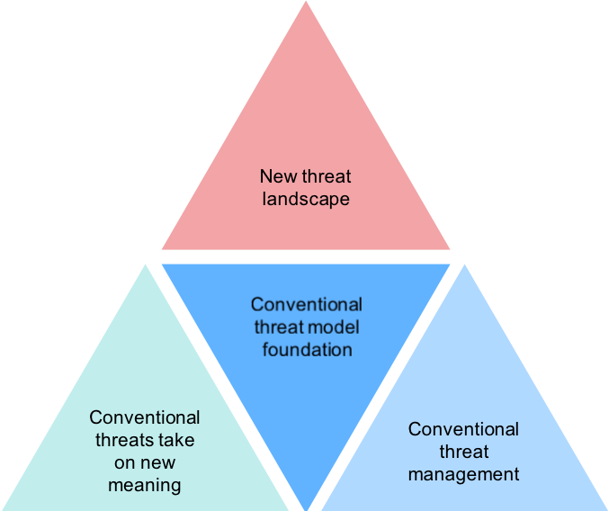
Threat Model
Notes:
Traditionally all software systems in Grey
We are interested in top triangle – blockchain has it’s own new threats associated with it

Slide 25
Security
51% attack?
SecOps
SRE
Engage Consultants – IBM Garage etc
Platform
Key Theft Security
( S.F.Y.L )
HSM – Disk Encrytion
Pen testing &TLS Audits
SmartContracts
Notes:
Hyperledger Fabric undergoes periodic Security and License Audits whose results are publicly
A security assessment for v1.1 was published by Nettitude in September of 2017, and , and the assessment for v2.0.x is in progress.
IBM Cloud requires that all services undergo pen testing and that all endpoints use TLS. Specifically,
TLS 1.2 is enabled for all endpoints. All communication between nodes (peer to peer, peer to orderer) is secured with TLS and all communication from the UI to the nodes is also TLS
IBM Blockchain Platform will have support for HSM in 3Q.
Platform – see slide 29

Slide 26
8 threats are common to blockchain:
Spoofing
Tampering
Repudiation
Replay attacks
Information disclosure
Denial of service (DOS)
Elevation of privileges
Ransomware
Notes:
8 threats are common to blockchain:
1. Spoofing
• Some malicious person or entity pretends to be or impersonates an authentic user, or the persons private keys are. Hyperledger Fabric attempts to mitigate this with having a high-quality Certificate Authority built in using the highest quality certificates x.509. The network or node operator needs to ensure certificates are managed in a safe manner, like the enrollment of new organizations and the ensure the distributed revocation lists are updated.
2. Tampering
• Data is modified or corrupted by inserting invalid or repeated events. Hyperledger Fabric has as well the best of quality encryption like sha-256 or ECDS [15]. These choices are built in to Hyperledger Fabric. Proper maintenance of the Hyperledger Fabric system should be maintained across all nodes in the network, Operators and Developers should decide which version should always be patched or updated be current according to valid LTS versions. Be aware data migration may be tricky or impossible, so run all your tests against when updating to a newer major release of Hyperledger Fabric.
3. Repudiation
• Entity cannot deny who did what. Strict logs should be setup and archived to track events that lead to ledger creation. This is built into Hyperledger Fabric, but administrators of the network must ensure logs are safely kept on encrypted disk volumes and archived to safe locations.
4. Replay attacks
• replaying of events will corrupt the blockchain itself. Hyperledger Fabric uses read/write sets to validate transactions. A replay of a transaction will fail due to an invalid read set.
5. Information disclosure
• Sensitive data is exposed either due to intentional breaches or accidental exposure. Hyperledger Fabric has built in TLS for in-transit encryption. It does not encrypt the data at rest, so either encrypt the data or use encrypted disk volumes.
6. Denial of service (DOS)
• DOS are malicious attacks that make normal access of the system difficult or impossible. Network and Node operator should ensure network security to prevent DOS attacks.
7. Elevation of privileges
• Gain higher levels of access to system than allowed. Issued identities cannot upgrade their access without manual review of access. Hyperledger Fabric deploys and runs all of its components in separate Docker containers. Operators are responsible for enforcing highest level Docker and container security, by limiting access and running SmartContract containers with the appropriate restrictions.
8. Ransomware
• Use crypto or other methods to access data off filesystem. Once again it it the operator’s responsibility to provide adequate virus, trojan as well as ransom ware protection software and to ensure that these cannot access nodes ledgers.

Slide 27
Caveat Emptors!
Upgrading from one version of HLF to another can be hard if not impossible, so upfront design is essential – use LTS versions like 1.4 – TEST TEST TEST
Keep event/transaction logs outside of ledger safely to recreate ledgers
Notes:
=need ref here!!

Slide 28
Take care with the code quality and deployment of your SmartContracts
SmartContracts are code that is executed to affect the blockchain, so they are ripe targets for malicious hackers. Hence paying attention to the quality of code is very important, this is achieved by agile test driven development, peer code reviews as well as organizational audits. Once chain code is distributed it is 'a shot to the moon'[13]
Notes:
it is hard then to change, update or patch bugs. This can be alleviated by CI/CD distribution techniques and pipelines, which can expose their own devops/SRE quality exposing their own vulnerabilities as well. By encouraging bug bounties as well as SmartContract penetration testing by external security expert entities like Veracode or Nettitude[] should add a further layer of security and privacy to the SmartContracts. Hyperledger Fabric offers multiple SmartContract language choices, so be careful on the language you choose to use, rather than use easy to use scripting languages like JavaScript or Typescript, use safer compiled languages like Java or Go. Also, DSL are showing up like DAML and these are new and do transpile to compiled code, which may expose vulnerabilities due to leak abstraction or immaturity of the language. DAML does code generate Rust or OCaml which is very secure Digital Asset's DAML SmartContract DSL conforms to extremely secure capabilities and is soon to be supported by Hyperledger Fabric

Slide 29
Flexibility choices to where run Hyperledger Fabric
VMWare OpenStack
Multi / Hybrid cloud
IBM Cloud Private (ICP)
IBM Z
IBM Power - Linux
Security Posture
IBM LinuxONE
COMMODITY
HARD
Intel – Linux
On premises
Notes:
Because of its distributed architecture, blockchain is best suited for the hybrid cloud model and can be deployed both in the public cloud and on premises.
The decision on where to deploy block- chain could, for example, depend on if a managed service is preferred for ease of use, or whether government, industry, or corporate regulations mean that data needs to be held locally.

Slide 30
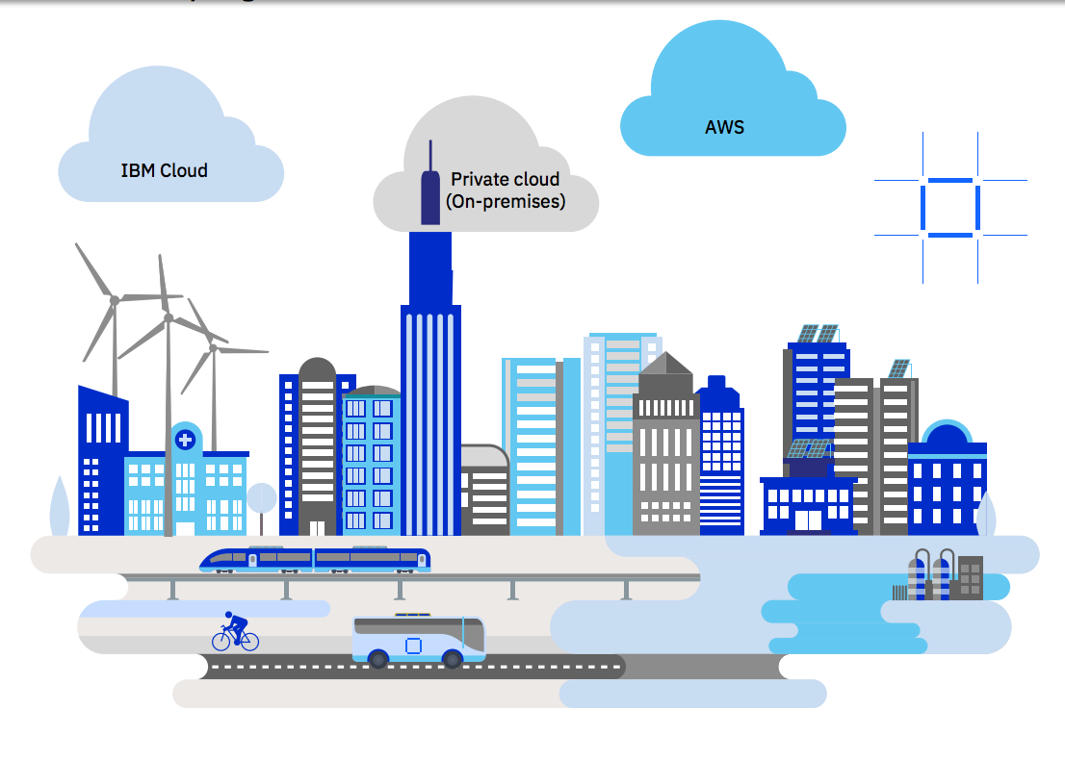
Deploy Hyperledger Fabric ot IBM Blockchain – ANYWHERE!
Notes:
Because of its distributed architecture, blockchain is best suited for the hybrid cloud model and can be deployed both in the public cloud and on premises.
The decision on where to deploy block- chain could, for example, depend on if a managed service is preferred for ease of use, or whether government, industry, or corporate regulations mean that data needs to be held locally.
next
You have Developed your first Hyperledger Fabric application How to get it into the cloud
Many options now
Just announce IBP anywhere!
A full-stack cloud platform that spans public, private and hybrid environments.
IBM cloud – reliabily – scalability – speed – IBM Garage / Consulting …
Build with a robust suite of advanced data and AI tools, and draw on deep industry expertise to help you on your journey to the cloud.
--------------------------
Hybrid Cloud on IBM Z

Slide 31
LinuxONE Security Enables Blockchain
Built-in encryption
Key management
Workload isolation
IBM Secure Service Container
Notes:
The IBM LinuxONE platform is designed to make applications
Perform faster and more efficiently
with the highest levels of security
Customized Go language

Slide 32

VM
Red Hat
SuSE
encryption
END TO END
Built in Encryption
LinuxONE hardware encryption:
Dedicated I/O processors
Crypto processors built right into microprocessor cores
Additional dedicated crypto processors via add-on accelerators
IBM Cloud Hyper Protect Crypto Services
IBM Key Protect
IBM Cloud data
IBM Secure Containers
Notes:
Encryption and decryption can decrease performance, and Linux- ONE has dedicated on-chip co-processors for hardware encryption and decryption of data without the typical processing overhead associated with software encryption. The low overhead of LinuxONE hardware encryption enables pervasive encryption to be practical, automatically protecting all data.
is a cryptography service designed to provide LinuxONE based security capabilities to the cloud with a complete set of encryption and key management services
Cloud advantage :::
IBM Cloud Hyper Protect Crypto Services:
The system provides high density and unique transaction in flight and
at rest protection accessible in the cloud
Integrates with key services: IBM Key Protect and IBM
This service has the industry's highest FIPS 140-2 Level 4 crypto
certification.
IKS encrypts the storage and customers can use their own key secured by IBM Key Protect. Note that the user must configure the IKS cluster they provide to IBM Blockchain Platform with the appropriate protection
The IBM Blockchain Platform console is provisioned in an IKS cluster managed by IBM. This IKS cluster is configured with the IBM Key Protect option.

Slide 33
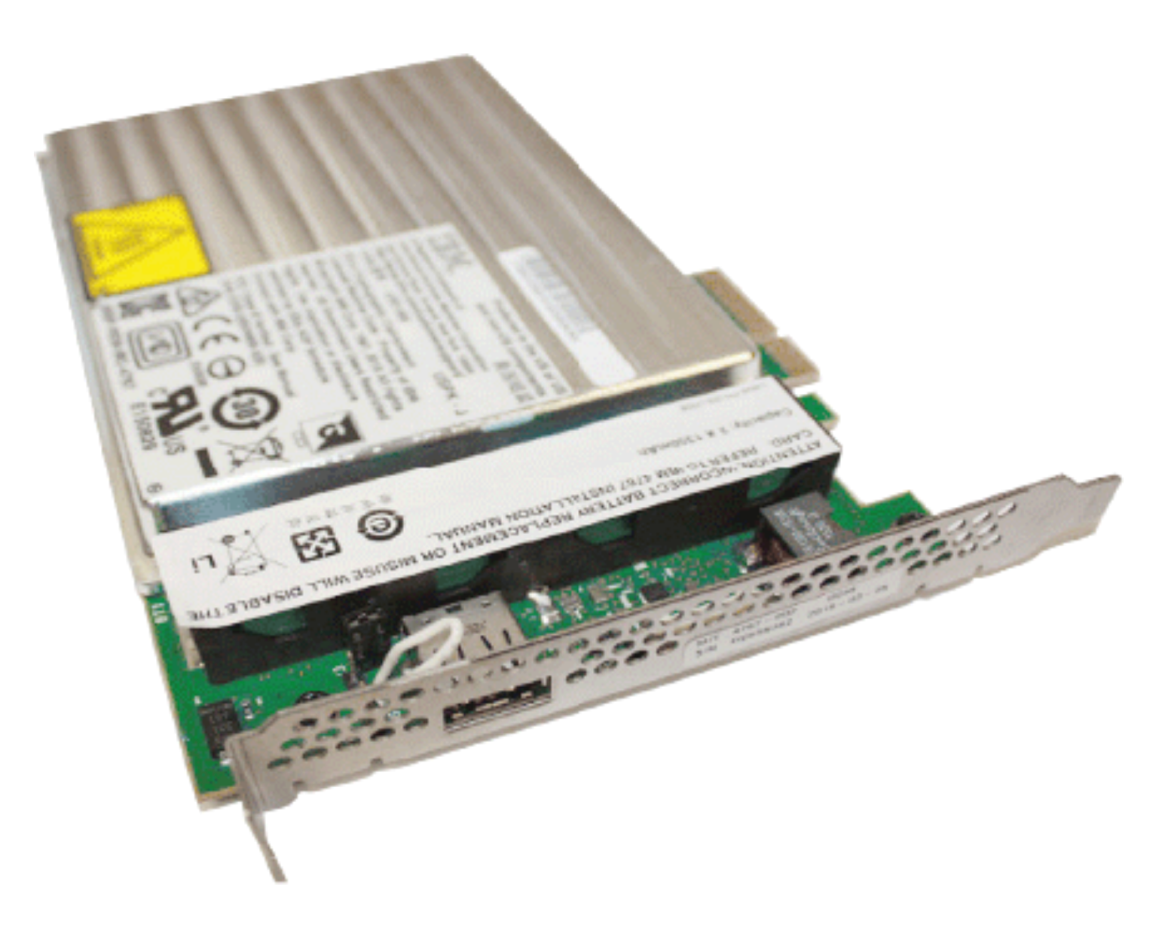
Air Gap Separation
EAL5+ Certification
Workload Isolation
Firmware ensures separation of running systems/VM’s on the same physical machine.
Hardware Security Module (HSMs)
Notes:
firmware virtualization of logical partitions (LPARs)
EAL5+, one of the highest commer-cially available certifications.

Slide 34
Go language is ported and optimized for LinuxONE to make these hardware solutions available for Hyperledger Fabric
Notes:
HLF WRITTEN in GO

Slide 35
Chaincode Encryption
Encrypt sensitive data stored on blockchain
Ordinarily data is stored in the clear. This data may be hidden by encrypting – caveat key management complexity
Chaincode encryption is achieved by leveraging the entities extension which is a BCCSP
cryptographic operations such as encryption and elliptic curve digital signatures.
Notes:
BlockChain Cryptographic Service Provider is the package that offers the implementation of cryptographic standards and algorithms.
For example, to encrypt, the invoker of a chaincode passes in a cryptographic key via the transient field. The same key may then be used for subsequent query operations, allowing for proper decryption of the encrypted state values.

Slide 36
Privacy
Channels
MSP/ Identity
Private Data
Compliance / Legal
Notes:
MSP Membership Provider
Membership Service Provider (MSP) comes into play — it identifies which Root CAs and Intermediate CAs are trusted to define the members of a trust domain, e.g., an organization, either by listing the identities of their members, or by identifying which CAs are authorized to issue valid identities for their members, or — as will usually be the case — through a combination of both.
The power of an MSP goes beyond simply listing who is a network participant or member of a channel. An MSP can identify specific roles an actor might play either within the scope of the organization the MSP represents (e.g., admins, or as members of a sub-organization group), and sets the basis for defining access privileges in the context of a network and channel (e.g., channel admins, readers, writers).

Slide 37
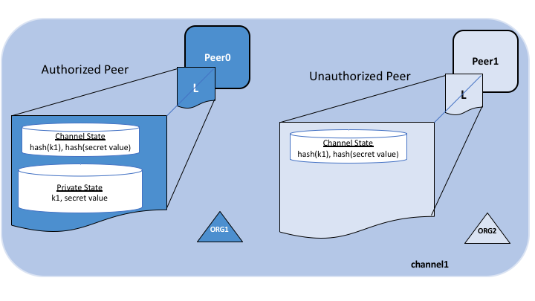
Private Data Collections
Offchain -> SideDB
A hash of that data, which is endorsed, ordered, and written to the ledgers of every peer on the channel.
Notes:
In cases where a group of organizations on a channel need to keep data private from other organizations on that channel, they have the option to create a new channel comprising just the organizations who need access to the data.
However, creating separate channels in each of these cases creates additional administrative overhead (maintaining chaincode versions, policies, MSPs, etc), and doesn’t allow for use cases in which you want all channel participants to see a transaction while keeping a portion of the data private.
The actual private data, sent peer-to-peer via gossip protocol to only the organization(s) authorized to see it. private state database on the peers of authorized organizations (sometimes called a “side” database, or “SideDB”),
The ordering service is not involved here and does not see the private data.
The hash serves as evidence of the transaction and is used for state validation and can be used for audit purposes.
Collection members may decide to share the private data with other parties if they get into a dispute or if they want to transfer the asset to a third party. The third party can then compute the hash of the private data and see if it matches the state on the channel ledger, proving that the state existed between the collection members at a certain point in time.

Slide 38
cryptographic protocol suite: strong authentication as well as privacy-preserving features such as anonymity the ability to transact without revealing the identity of the transactor, unlinkability the ability of a single identity to send multiple transactions
Identity Mixer (Idmix)
Notes:
without revealing that the transactions were sent by the same identity.
Why??? Do this Chatter – things going on

Slide 39
Idmix - Zero Knowledge proofs( ZKP) to prevent passing of sensitive data
Anonymous client authentication with Identity Mixer
privacy-preserving exchange of assets with Zero-Knowledge Asset Transfer (ZKAT).
Two millionaires wish to know who is richer; however,
they do not want to find out inadvertently any additional information about each other’s wealth
Yoa’s Millionare Problem
Notes:
https://securecomputation.org/docs/ch1-introduction.pdf

Slide 40
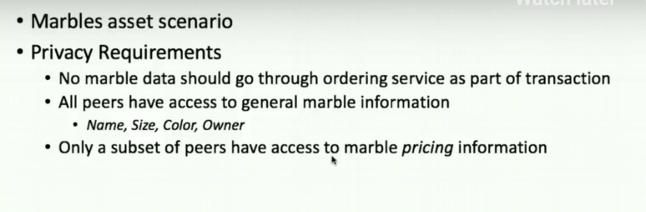
Private data – Marbles asset scenario
Notes:
Off video

Slide 41
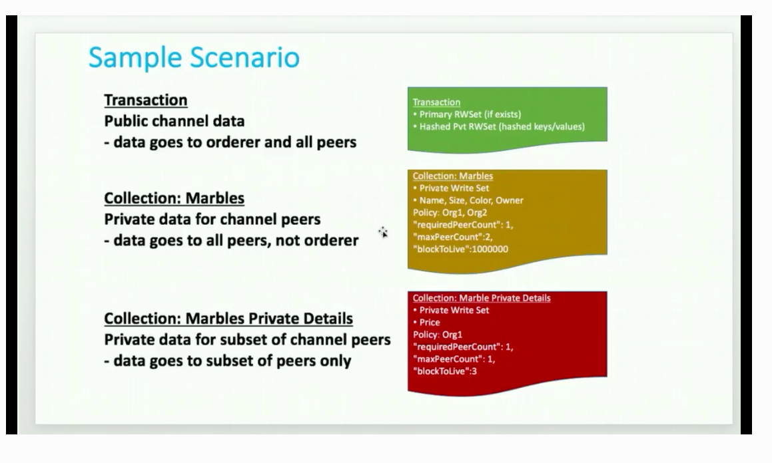
Private data: Marbles asset scenario
Notes:
If one peer offline it’s OK
Only Org 1 has access
Also
Block to live – even private data can expire ( super sensitive )
blockToLive: 3 – 3 blocks then purged ( 0 forever )

Slide 42
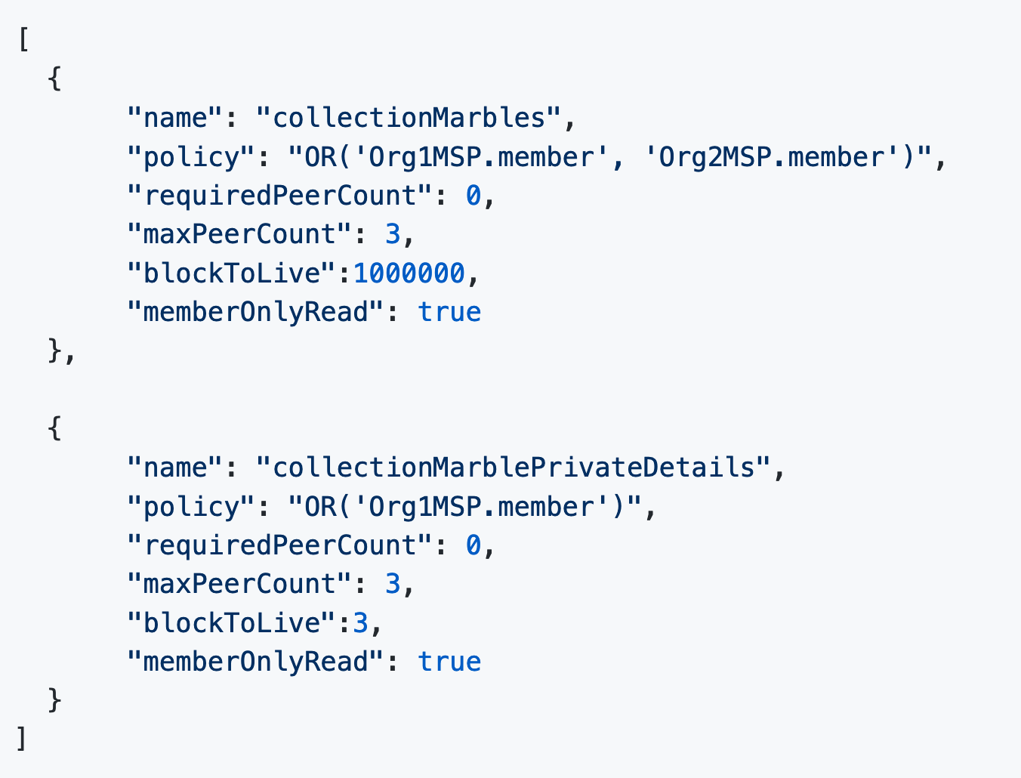
Private data config file ./collections_config.json
Notes:
If one peer offline it’s OK
Only Org 1 has access
Also
Block to live – even private data can expire ( super sensitive )
blockToLive: 3 – 3 blocks then purged ( 0 forever )

Slide 43
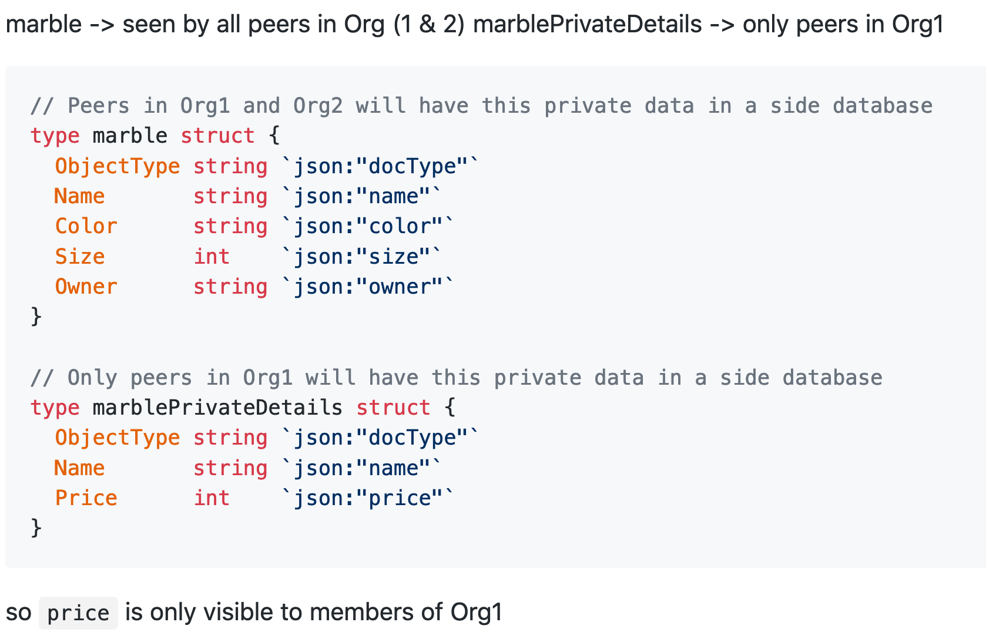
Private data SmartContract ./chaincode.go
Notes:
If one peer offline it’s OK
Only Org 1 has access
Also
Block to live – even private data can expire ( super sensitive )
blockToLive: 3 – 3 blocks then purged ( 0 forever )

Slide 44
Hyperledger Fabric (HLF) ==> LEARNING PATHS / REFERENCES
Hyperledger Fabric Tutorials Private Data Tutorial Marble Data https://hyperledger-fabric.readthedocs.io/en/release-1.4/private_data_tutorial.html IBM Code Patterns [ https://developer.ibm.com ]
Build your first private blockchain network on InterPlanetary File System
Comprehensive storage solution addresses data loss, duplication, tampering problems, and more
https://developer.ibm.com/patterns/build-first-private-blockchain-network-interplanetary-file-system/
Medical Data using IBM Cloud IBPv2 https://developer.ibm.com/patterns/storing-private-data-off-chain-using-blockchain-think-healthcare-use-case
IBM LinuxONE for dummies
https://www.ibm.com/downloads/cas/LBOVYYJJ
HLF security audit process https://www.hyperledger.org/blog/2018/02/07/hyperledger-fabric-1-0-release-process
Blockchains and SmartContract security - Chris Wysopal, CTO Veracode
https://searchsecurity.techtarget.com/news/252460033/Chris-Wysopal-talks-blockchain-hype-and-realistic-uses

Slide 45
Hyperledger Fabric (HLF) ==> LEARNING PATHS / REFERENCES
Practical Byzantine Fault Tolerance
http://pmg.csail.mit.edu/papers/osdi99.pdf Private vs. Public Blockchain: What are the Major Differences? https://medium.com/luxtag-live-tokenized-assets-on-blockchain/private-vs-public-blockchain-what-are-the-major-differences-d92a504f3a4a
The Ultimate Guide to Consensus in Hyperledger Fabric
https://www.skcript.com/svr/consensus-hyperledger-fabric/
How to Build an End-to-End encryption in Hyperledger Fabric
https://www.skcript.com/svr/end-to-end-encryption-hyperledger-fabric/
The Blockchain and the CAP Theorem
https://www.infoq.com/news/2017/04/blockchain-cap-theorem/

Slide 46
Thank You! Stay tuned @gsteinfeld
Sign up today for a free IBM Cloud Account https://ibm.biz/BdznyC
Upcoming events:
Wednesday, August 28, 2019
Hands On :: Reactive Programming for the Impatient Developer
Wednesday, September 18, 2019
How to Write, Debug, and Test Smart Contracts
Saturday, September 28, 2019
Akka Actors - https://www.vtcodecamp.org/

